Slide 1
Glenwood City
6th Grade Orientation
2024-2025

Slide 2



Middle/High School Office Staff
Athletic Coordinator & Administrative Assistant to Principal - Casey Nolde 715.265.7472
Attendance Coordinator & Administrative Assistant to GCE/ GCMS/ GCHS - Samantha Johnson 715.265.7473
MS/HS Principal - Marcy Burch 715.265.4266

Slide 3



District Office
Superintendent - Patrick Olson
715.265.4757
Director of Student Services - Erin Spaeth 715.265.7120
Food Service Director - Christa Edin 715.265.7121

Slide 4
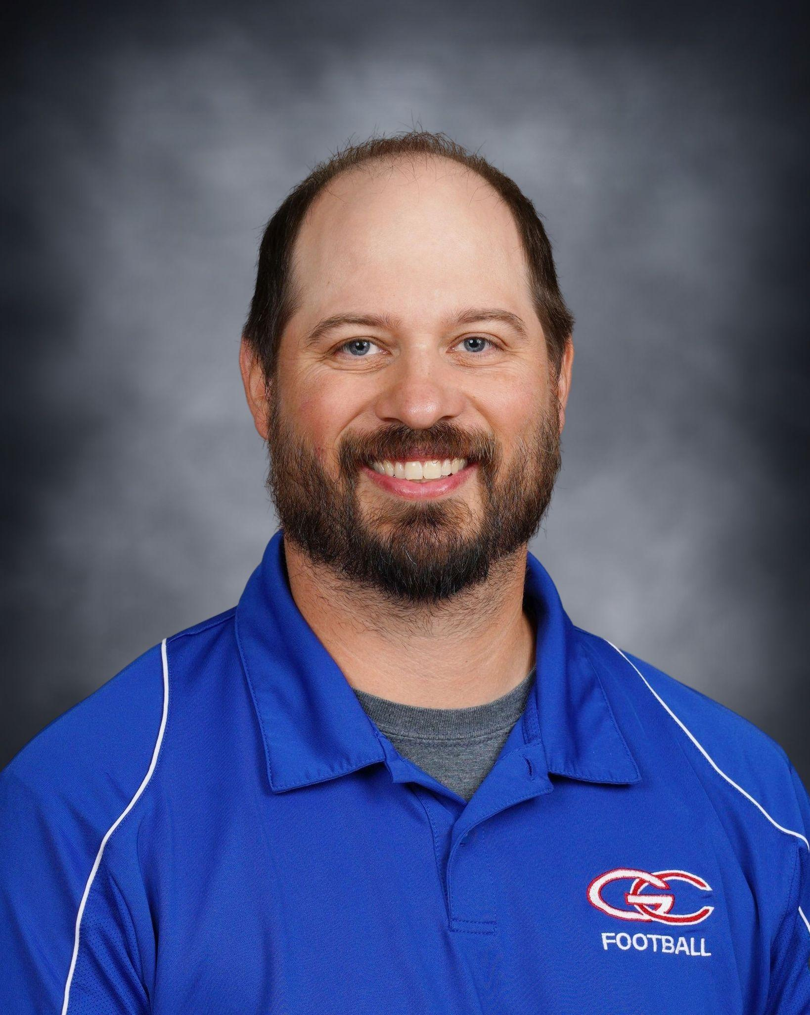

Athletic Director & Middle/High Counselor
Athletic Director - Jake Score 715.265.7842
Guidance Counselor - Shelly Laffin 715.265.7467

Slide 5


Transportation
Transportation Director - Ryan McVeigh 715.265.7123
Transportation Director - Randy Ketola 715.265.7123

Slide 6
Getting to School
Bus - Same criteria and expectations as elementary school
Bike - wear helmet and lock bike to bike rack.
Walk/Get a ride
Pickup and Drop off are to only be done in the lower parking lot. There are signs designating pickup and drop off locations.
Arrival after 7:45 AM. First period begins at 8:00 AM.
Once students get here they can go to commons where breakfast may be purchased. Students are unsupervised and not to be in the gyms.

Slide 7
After School
*Students who are not in a scheduled activity are not allowed to stay and “ watch”
*If there is a gap between the end of school and a sporting practice or other activity, you must go home and return
* All students in the building outside of school hours must be under the supervision of an adult

Slide 8
Lockers
Every student is assigned a locker
Lockers are property of the school district. This means they can be searched at any time, without permission
Students are responsible for the contents of their locker and the school is not liable for any losses
School issued padlocks are optional and are available from Mrs. Johnson in the office.
Personal locks may NOT be used on student lockers, only school district issued locks are to be used.

Slide 9
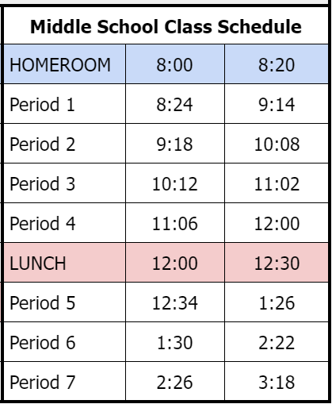
6th Grade Classes
There are 7 periods in each day along with a 20 minute homeroom to start the day.
  2nd period is band/choir/study hall
  6th period of each day consists of WIN time
Middle school lunch period is from 12:00-12:30
You may bring a lunch from home OR have hot lunch.

Slide 10
Everyday Classes
6 Week Rotation Classes
6th Grade Classes
Physical Education
Art
Agriculture/Technical Education
Family and Consumer Science
Computers
Spanish
Reading & Writing (ELA)
Social Studies
Math
Science

Slide 11
What is Skyward?

Slide 12

Families are able to:
Check food service balance & purchases
Online Registration Use Consents
Check or Update Emergency Contacts
View Student schedules after you register
See student current grades and Report Cards

Slide 13
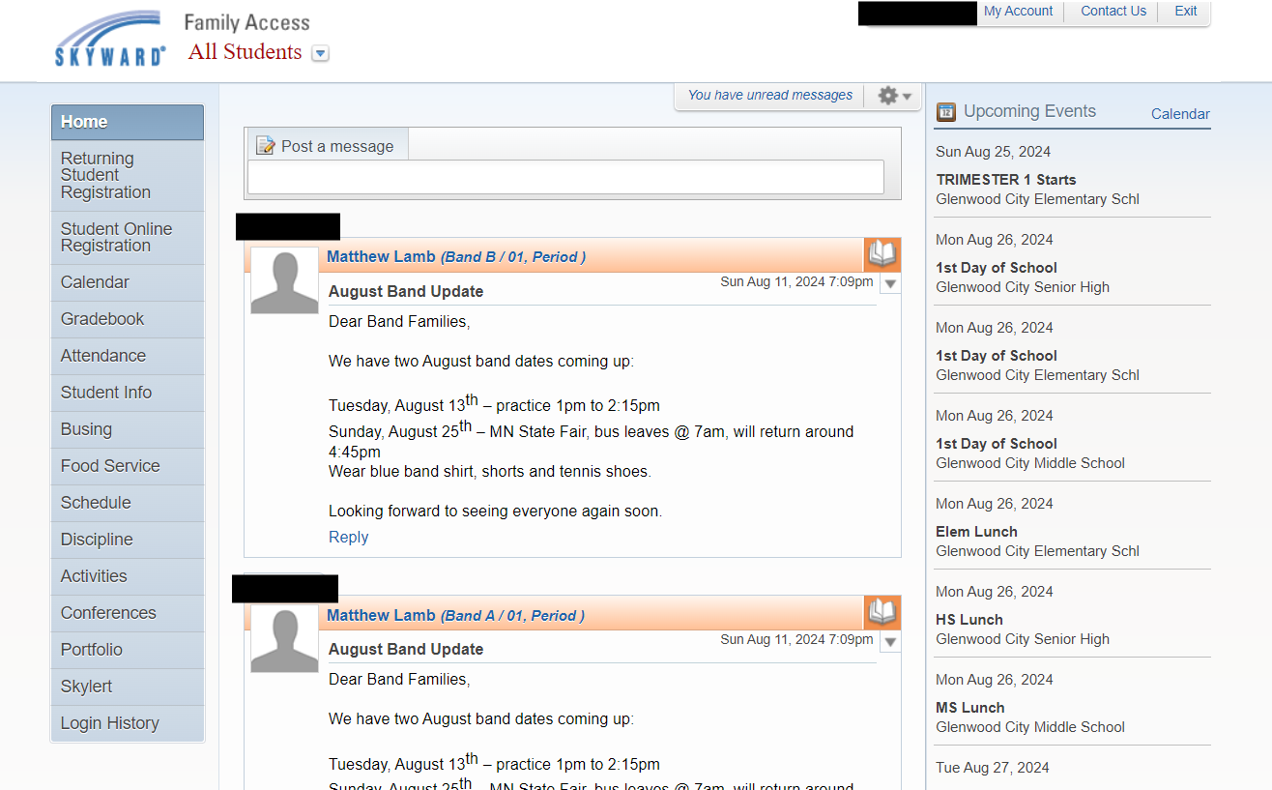

Slide 14



Organization
Organization is important!
We recommend that students use a planner or other method to keep track of assignments
Teachers may Google Classroom
  Encourage students to check this regularly
Skyward is used to post grades as well as as see assignments
  * Make sure you are able to log on to skyward. If you need assistance please contact the Middle/High School office

Slide 15
Report Cards
There are 4 quarters and grades are posted to skyward for each.
Progress report emails will be sent out at Mid-Quarter to families as a reminder to check your students grade
Report cards are sent out for each semester.
Regular attendance and completing homework are very important to maintaining good grades

Slide 16
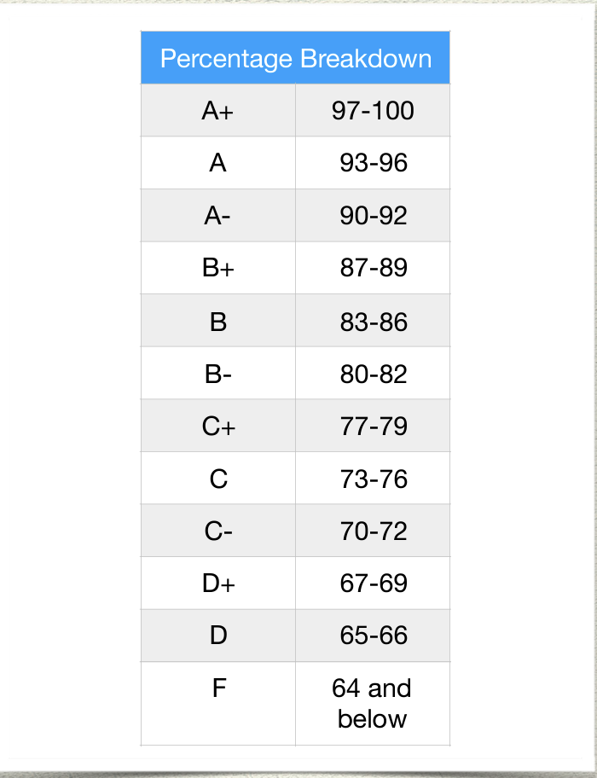
Grading is different in middle school.
In elementary school, grades looked like:
beginning to develop (1) progressing towards (2) meeting(3)
exceeding (4)
In middle school grades will be reported as letters
If a student got all 4’s in elementary school it does not necessarily mean they will earn all A’s in middle school

Slide 17
Extra-Curricular Activities
The Middle School day ends at 3:20pm. Bus right after school in front of the GCHS/MS entry.
Sixth grade students are able to join Student Council, FFA, Cross Country, Wrestling, and Track & Field. Registration for sports is online at:
https://glenwoodcity-ar.rschooltoday.com/
All eligibility requirements can be found on the activities tab on the district website:
https://www.gcsd.k12.wi.us/activities/

Slide 18
What if I need to get a message to my child?
Is it urgent?
Remember, this means we are pulling a student from class
Is it information that can wait until after school?
If it will result in a change in the students normal routine, please call or email the office
If we are able, we will wait to deliver message until student is in homeroom or flex period as to not disrupt any core classes.

Slide 19
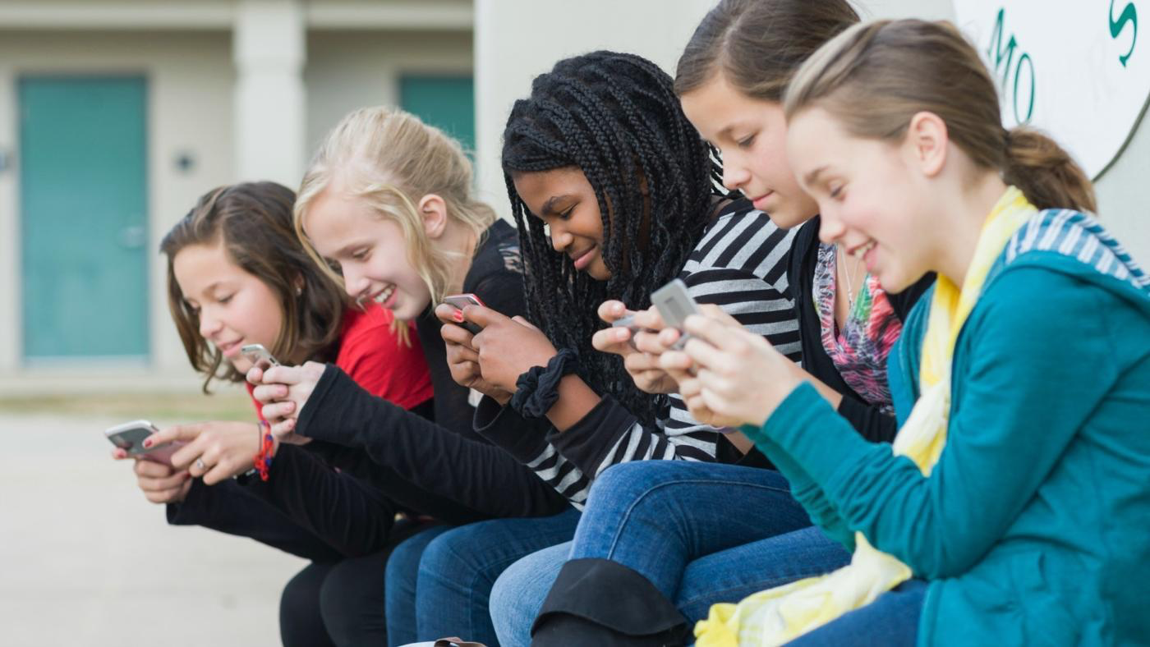
No phones from 8:00 AM to 3:20 PM
Leave at home, or in your locker
Any work that requires technology will be done on a chromebook… no phone needed

Slide 20
Students shall leave all cell phones and other devices silenced and kept in a locker and/or backpack. Electronic devices are not allowed in the classroom unless directed and given permission by the teacher.
Teachers may allow students to use the electronic device for medical or educational reasons
Students may NOT use electronic devices in bathrooms/locker rooms during school hours on school premises owned or rented by the school district including sponsored school district activities
Students may not record, post or otherwise capture unauthorized images of other students
Cell Phones/Communication Devices

Slide 21
So what happens if…….
As approved by the school board in our 2024-2025 handbook, consequences are as follows:
First Offense: The electronic device will be confiscated and securely held until the end of the school day, then it can be collected by the student. The student will have a conference with the high school principal.
Second Offense: The electronic device will be confiscated and securely held until the end of the school day, at which point it can be collected by the parent. The student will receive an after school detention.
Subsequent Offenses: The electronic device will be confiscated and securely held until the end of the school day, at which point it can be collected by the parent. The student will receive an after school detention. Additionally, the student will turn in their cell phone to the high school office at the beginning of each school day for the duration of 5 school days.

Slide 22
Dress Code/Attire
Examples of prohibited clothing include, but are not limited to:
Attire with vulgar, discriminatory, or obscene language
Attire that promotes illegal or violent conduct (weapons, drugs, alcohol, tobacco)
Clothing that exposes the midriff, or undergarments,
Sagging or low pants
No hats or other non- religion affiliated headgear to be worn during the school day (unless part of a school spirit day or otherwise pre-arranged with administration)
An alternative clothing option will be provided if the student has nothing to change into
The purpose of dress code is to ensure the health and safety of students in a supportive school environment.

Slide 23
Attendance
Regular attendance at school is incredibly important
Absences considered “ excused” IF VERIFIED BY THE PARENT/GUARDIAN.
Illness (includes doctor and dental appointments)
A death in the family
A court appearance
A special religious service; a family emergency
A quarantine
School bus delay
School authorized field trips
Pre-approved absences
Absences without prior approval from the school, may be considered unexcused and truant and the school reserves the right to deny a request for a pre-arranged absence. Extended absences because of illness and hospitalization will be accommodated.

Slide 24
TRUANCY is defined by state law as any absence from school for either a partial or a full day for which there is no acceptable reason as defined in the laws and district policy.
HABITUAL TRUANCY is defined as any pupil who is truant for part or all of five or more days during a semester. (Wisconsin Statute Section 118.16(1)(a) and (c))

Slide 25

Please call the attendance line for the appropriate office before 9:00 a.m. each day when your child is going to be absent. The office has voice mail to record messages if someone is not available. Please leave the first and last name of your student and the reason for absence.
Middle and High School Attendance Line: (715) 265-4266
Call-In Policy

Slide 26
Pre-arranged Absences
For pre-arranged absences, please follow these guidelines:
Parent/guardian should contact the office to explain the reason, time and dates of the expected absence
The students should complete all missed work and return it to the teacher
*NOTE: Children wishing to exercise their religious rights may be excused from traditional holiday festivities at school (such as parties, plays and concerts). The absence includes the actual time of the event rather than the entire day. During such festivities "in-house" accommodations can be made or parents may take their child/children home.
Appointments During The School Day
If you have appointments during the school day (Doctor, Dentist, Counseling, etc.) please get an excuse note from the appointment office before you leave. When you return to school turn the note into the Office and attendance will be updated accordingly.

Slide 27
Chronic Absences
Students who exceed 18 non-medically verified partial or full days absent within the school year are considered to be chronically absent and may be required to make up their missed time as assigned by the principal. (Medically verified absences would include notice from a doctor, dentist, chiropractor, optometrist, or orthodontist from whom the student has received care.) All other absences, excused or unexcused, may apply toward the 18 partial or full-day maximum
TARDIES
A tardy is defined as being up to 10 minutes late to an assigned class.
A student who is more than 10 minutes late to an assigned class will be counted absent (unexcused) for that day.

Slide 28




We will learn, laugh & grow together!
We are here for you and excited to have you as a part of our GC Family!

Slide 29
Things you might want to know
Students
Parents
Will I be late?
What if I am lost?
What about the bathroom passes?
What about grades?
What about social media?
Friend issues?

Slide 30
Questions?

